Slide 1
Banking System
-A Standalone program to display the working Of A bank

Slide 2
The Home Program
The home program displays a menu to the user through which he or she can select functions.
The user may select different banking function like withdrawal of money , deletion or creation of an account
We have used a switch case to execute different functions based upon the choice of the user.

Slide 3
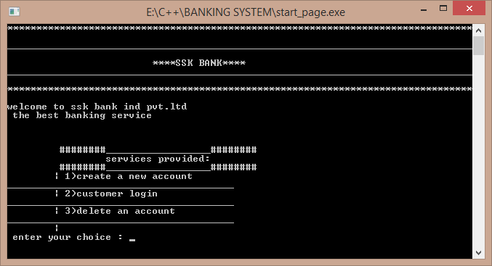
The sample Home page

Slide 4
The Modules
The each service provided by the home menu is divided into further modules.
Each module is written in form of a function in a another file.
These files are included in the pre-processor directives.
The names of the modules are : login , create , delete.
The program also consists of the text files , which act as the data bases.

Slide 5
Create Module
This module first of all opens the two databases using file pointers.(files opened in append mode).
It accepts the account number , name , date , balance , type of account from the user.
Using fseek function the cursor of the file is set at the final position.
From there fprintf function is used to store the data in a formatted way

Slide 6
Login Module
Using this module , the user can look into his or her own account , details regarding the last login.
The user has to enter the username , password , the account number , if all these match to a single account , that account is opened.
When the user enters the account number , using this account number the records are searched in a sequential order using fscanf function . (since the records are in record manner).
Upon finding the right result , it gives the details regarding the account like account balance etc.

Slide 7
Login module (continuation )
After displaying the account details , the program further asks us what we want to do , whether we want to do a transaction or we want to logout.
Hence further we can make a withdrawal or a deposit.
These changes are directly made in the directory.

Slide 8
Delete Module
Delete module is used so as to delete a particular record.
The entered record may be anywhere , hence first each record is matched sequentially with each record.
For this process to carry on , two new files are created and two are previous ones are opened.
If a particular record that is matched with the record present in the file ,that particular record is not copied in the new file.(use of continue statement).

Slide 9
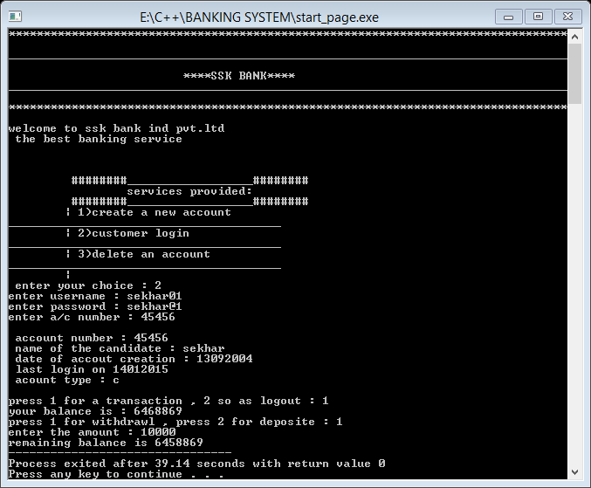
SAMPLE WORKING

Slide 10
DATABASE 1 : The customer information
The data is recorded the following order :-
Account no. Name date opened last login balance account type
(s or c)
The spaces between these data are the delimiters for the fscanf function.
This text file contains all the information of the account .

Slide 11
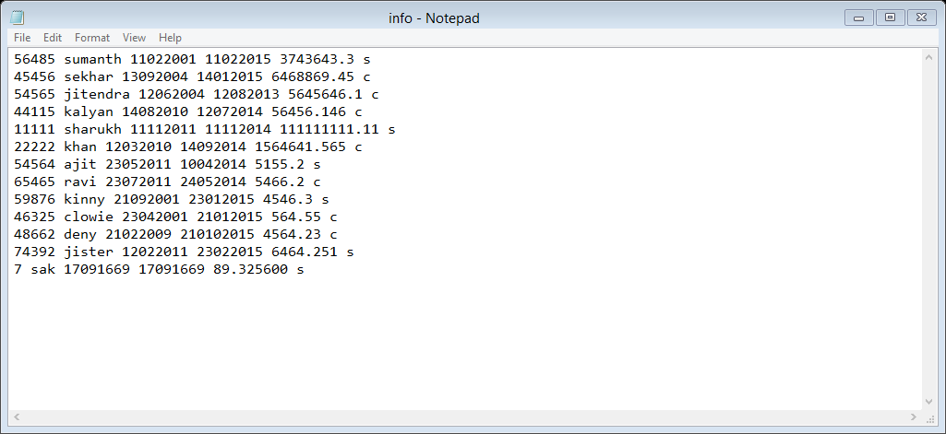
Continuation: (sample database) :

Slide 12
DATABASE 2:username and password
The second data base consists of the user names and passwords of the user.
The format is :
Username Password
Here again the delimiter is space for the fscanf function.
The user entered password is matched with password present in this database.

Slide 13
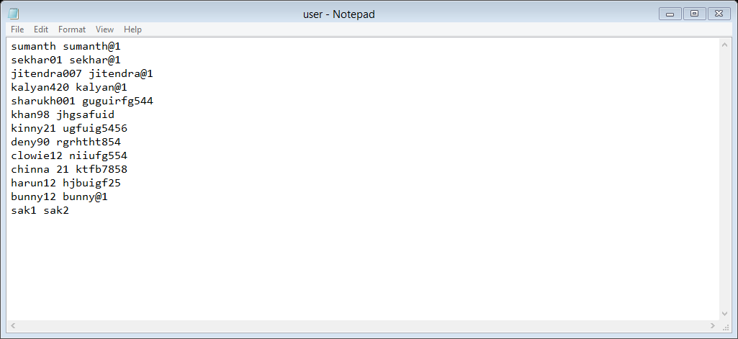
Continuation :

Slide 14
WORKING
case 1
case 2
case 3
Home page (main( ))
info.txt
Create( )
Login( )
user.txt
deletE( )

Slide 15
THANK YOU
DONE BY:-
Sekhar Karedla
P Kalyan Jitender
Sumanth Paruchuri

